Slide 1

SRM INSTITUTE OF SCIENCE AND TECHNOLOGY
SCHOOL OF COMPUTING
DEPARTMENT OF DATA SCIENCE AND BUSINESS SYSTEMS
18CSP109L - MAJOR PROJECT
Vehicle Health Analysis and Spare Parts E-Commerce
Student 1 Reg. No: RA1911027010058
Student 1 Name: YUVRAJ SINGH CHAUHAN
Student 2 Reg. No: RA1911027010007
Student 2 Name: AVINASH REDDY VASIPALLI
Guide name: Dr. T. KARTHICK
Designation: Associate Professor Department: DSBS

Slide 2
Table of Contents
Abstract
Literature Survey
Problems with Existing Systems
Proposed System
Problem Identification and Description
Requirements
Architecture Diagrams
UML Diagrams
Modules and Algorithm Description
Performance Measure/Evaluation
Result and Analysis
Journal/Conference Paper Publication Details

Slide 3
Abstract
The automotive industry has witnessed a surge in the use of technology to improve efficiency and accuracy in various aspects of vehicle maintenance.
The "Vehicle Health Analysis and Spare Parts E-Commerce" web application aims to simplify vehicle maintenance and repair for vehicle owners, insurance companies, and spare parts businesses.
The application utilizes Python and Streamlit for vehicle health analysis and PHP and MySQL for its spare parts E-commerce component. .
In addition, the spare parts E-commerce component enables users to purchase genuine spare parts for their vehicles directly from the manufacturer.

Slide 4
Literature Survey
Title | Methodology | Observation
Vehicle Health Monitoring and Analysis May 2016, Parmesh K. R | Modern vehicles are integrated with more number of ECUs and sensors which make them smarter in terms of engine decisions, performance, fuel efficiency, security and stability. | ECUs provides useful data in the form of diagnostic codes via OBDII (on-board diagnostics) protocol, these codes determine a specific issue in the vehicular system which is used by service technicians to address the issues occurred.
A Vehicle Health Monitoring System Evaluated Experimentally on a Passenger Vehicle October 2006, Hok K. Ng, Robert H. Chen, Jason Speyer | A residual generator and a residual processor are designed together to detect and identify actuator and sensor faults of the Buick LeSabre rapidly. The residual generator includes fault detection filters and parity equations. | A real intermittent sensor fault occurred and was immediately detected and identified. The real-time evaluation demonstrates that the vehicle health monitoring system can detect and identify actuator and sensor faults under various disturbances and uncertainties with almost minimal detection latency.

Slide 5
Title | Methodology | Observation
Automotive vehicle Health Monitoring and Damage Detection System February 2022, Shankar D. Birajdar, Atul R. Saraf, Nilesh G Patil | A damage detector is affixed to a surface of a material for detecting a damage or crack inside the material or vehicle body. In response to detecting a damage, a damage indicator is generated, A microstrip antenna /nanostrip antenna communicates the damage indicator to an external device. | The microstrip antenna detects the damage and the time when the damage was detected. Additionally, the antenna may associate other information with the damage indicator such as temperature and acceleration information.
Demand Forecasting for Motor Vehicle Spare Parts January 2012, J. J. Strasheim | A variety of alternative forecasting techniques were evaluated for this purpose with the aim of selecting one optimal technique to be implemented in an automatic reordering module of a real time computerized inventory management system. | Vehicle spare parts selected the optimal technique to forecast vehicle parts for the upcoming future so that the stock for those parts can be replenished.

Slide 6
Problems in Existing Systems
Limited Data Availability: The accuracy of the vehicle health analysis and insurance prediction relies on the data that is available. If the is no data, then the analysis and predictions is impossible.
Reliance on Sensors: The vehicle health analysis component relies on sensors in the vehicle to collect data
Limited Scope: The website's analysis and recommendations are limited to the information provided by the sensors and the algorithms used. There may be other factors that are not considered that could impact the health of the vehicle.
Halt of Spare Parts Production: If the vehicle is of very old model or doesn't have that many sales, the manufacturer may completely halt the manufacturing of that particular vehicle model's spare parts.

Slide 7
Proposed System
As mentioned in Results a multi Algorithm approved showed better results so to add more accuracy we propose 2 algorithms for data integration and cleaning
ANFIS
Adaptive Network based Fuzzy Inference system is a backpropagation learning algorithm that has 5 layers to analysis and give output by integrating the input variables.
This process is repeated until optimum output is obtained. ANFIS is time taking but with large datasets it can produce accuracy at the highest level.
Restricted Boltzmann Machine
Even by performing Deep learning techniques and data cleaning on large datasets, anomalies cant be removed and can effect the model efficient.
To improve this we use restricted bolzaman constant that has hidden layers compressed, even without a output this helps in adjusting weights to increase accuracy.

Slide 8
Problem Identification and Description
Insurance Prediction: The website uses machine learning algorithms to predict the insurance amount, and to prevent costly repairs and breakdowns.
Spare Parts E-commerce: The website provides a secure and convenient platform for the purchase of genuine spare parts.
Performance and Reliability: The website aims to provide high performance and reliability, ensuring that users can access and use the website without any downtime or technical issues.
Security: The website aims to provide a secure platform for transactions and user data, protecting users from any potential security risks.

Slide 9
Requirements
Functional:-
Vehicle Health Analysis: Process, Analyze and predict the estimated insurance claim that a user can get based on the internal condition of their vehicle’s health.
Spare Parts E-Commerce: Allows car owners to get the replacement of the damaged part of their car directly from the manufacturer at the best price.
Non-Functional:-
Usability: The website have an intuitive and user-friendly interface for easy navigation and efficient search.
Performance: Ensure fast response times and minimal latency, especially during data analysis and search operations.
Security: Implement robust security measures to protect user data, including personal information and payment details.

Slide 10
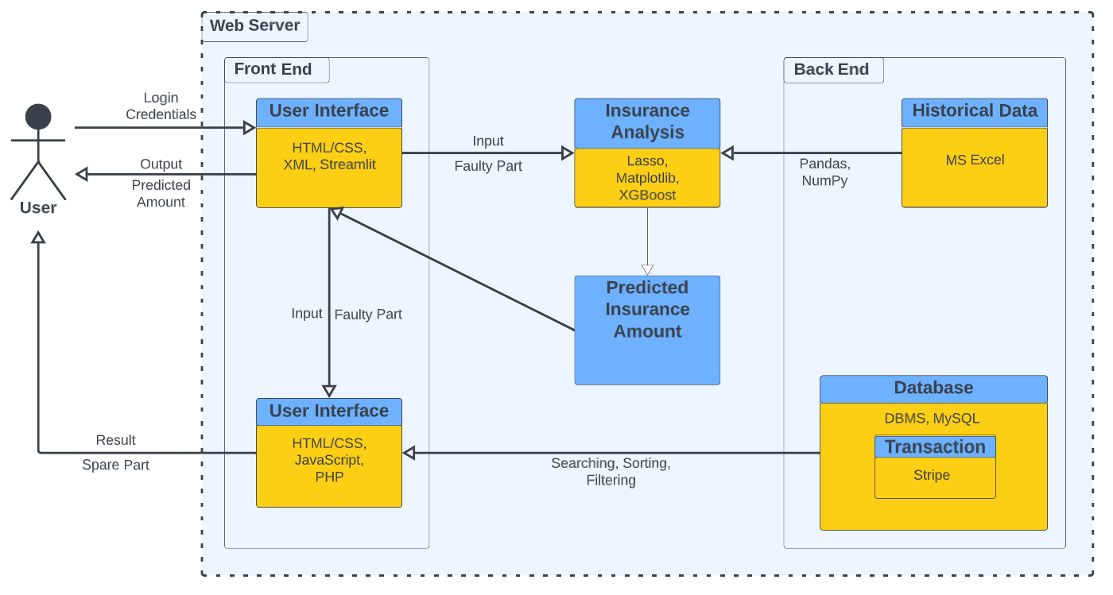
Architecture Diagram

Slide 11
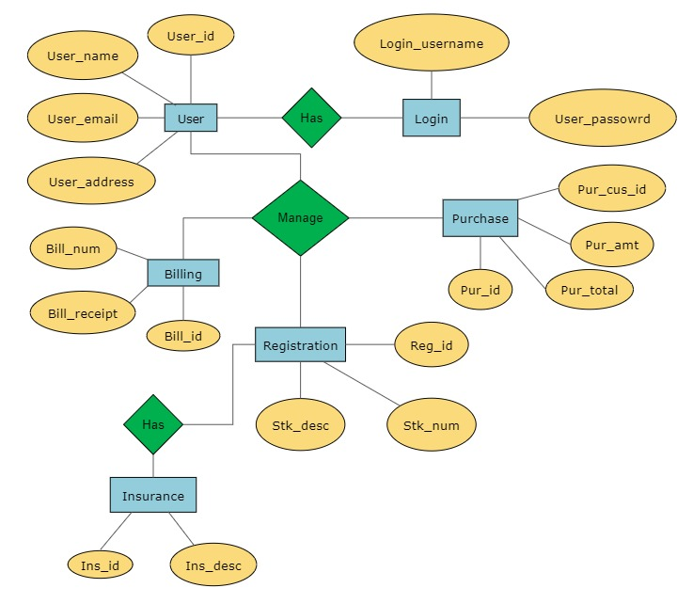
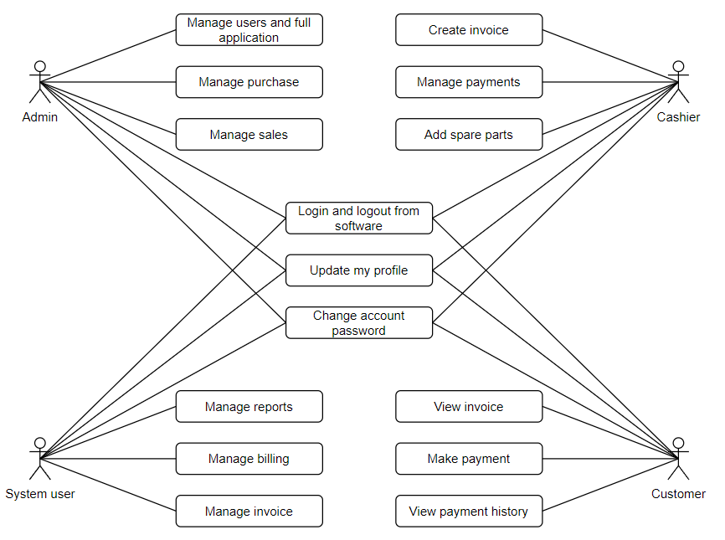
Use Case Diagram
ER Diagram

Slide 12
Modules and Algorithm Description
The vehicle health analysis component, the website is built using Python and the Streamlit framework. The following are some of the modules and algorithms used in this component:
Pandas - for data manipulation and analysis
NumPy - for numerical computation
Scikit-learn - for machine learning algorithms such as regression, classification, and clustering
Matplotlib - for data visualization
The vehicle health analysis component uses Lasso machine learning algorithm to predict premium and price of vehicle this is trained on historical data.

Slide 13
Comparison of different algorithms like Random Forest, Decision tree and artificial neural network with Lasso regression with the given data set. Since the data set is limited a proper conclusion was not obtained.
Deep learning towards vehicle fault diagnosis is one of the most interesting way to analysis and predict the vehicle fault in an attempt to do DNN model is used.
For the spare parts E-commerce component, the website is built using PHP and the MySQL database management system. The following are some of the modules and algorithms used in this component:
HTML/CSS - for website design and layout
JavaScript - for front-end functionality
PHP - for server-side scripting
Xampp Server – Host the website
MySQL - for database management and storage

Slide 14
Performance Measures/Evaluation

Slide 15
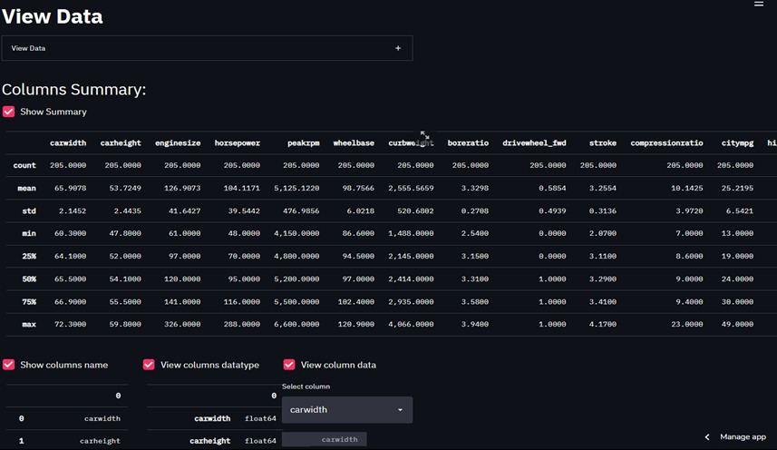
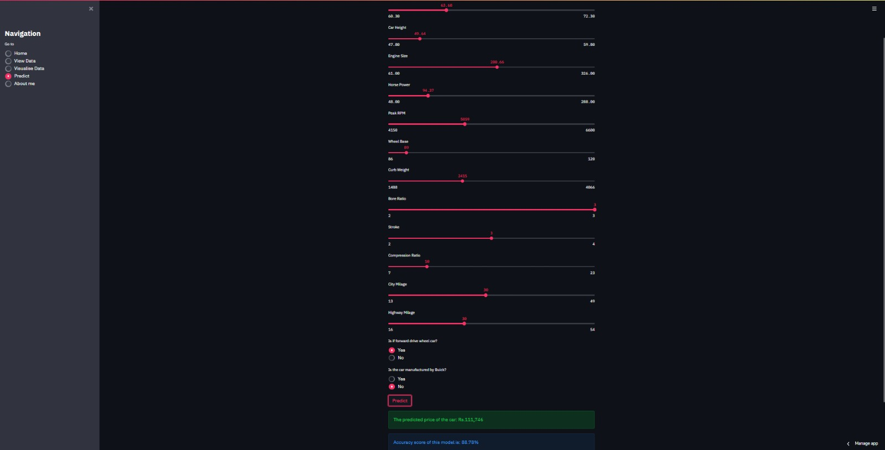
Results and Screenshots
Prediction
View Data

Slide 16
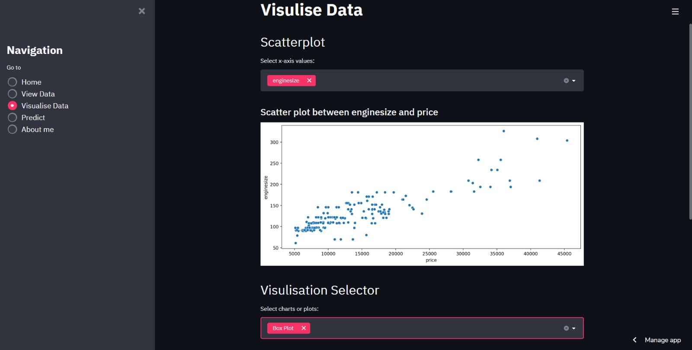
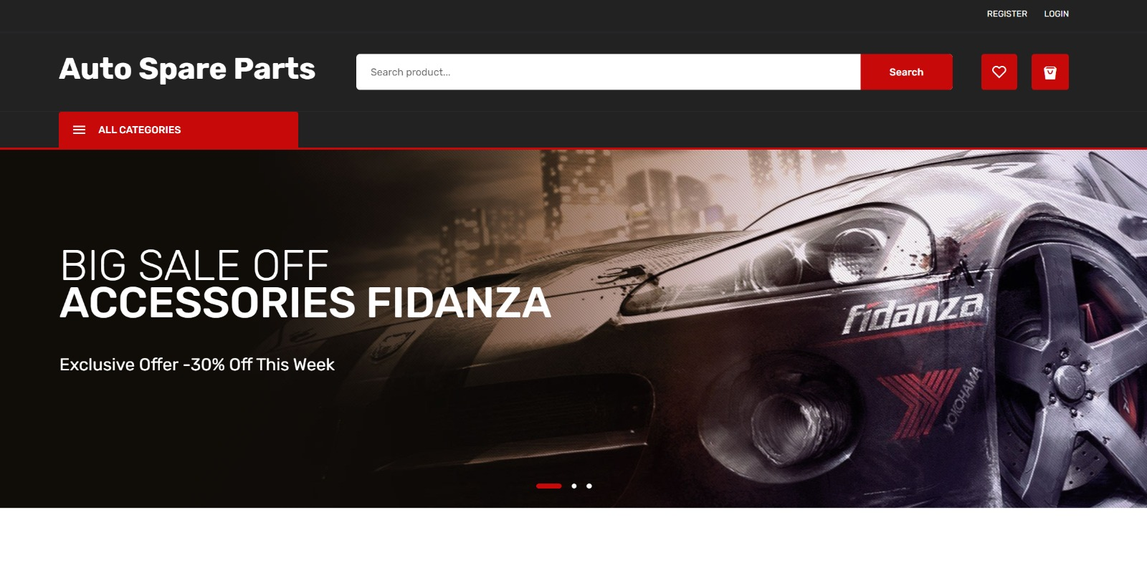
Visualization data
Home Page

Slide 17
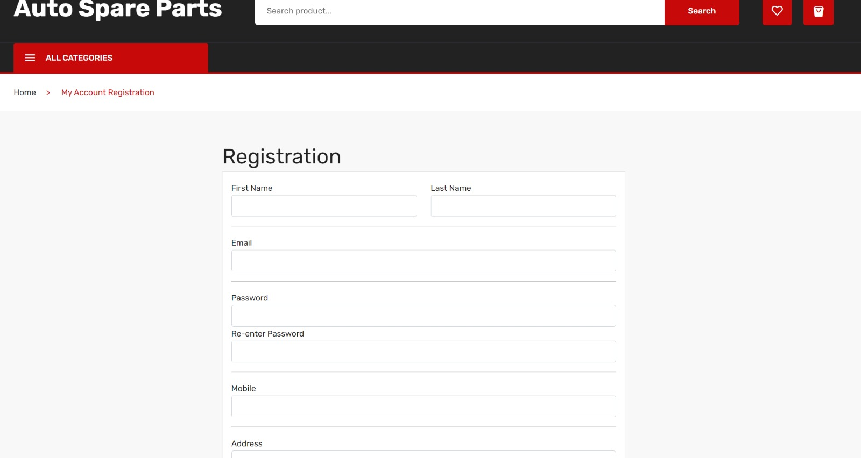
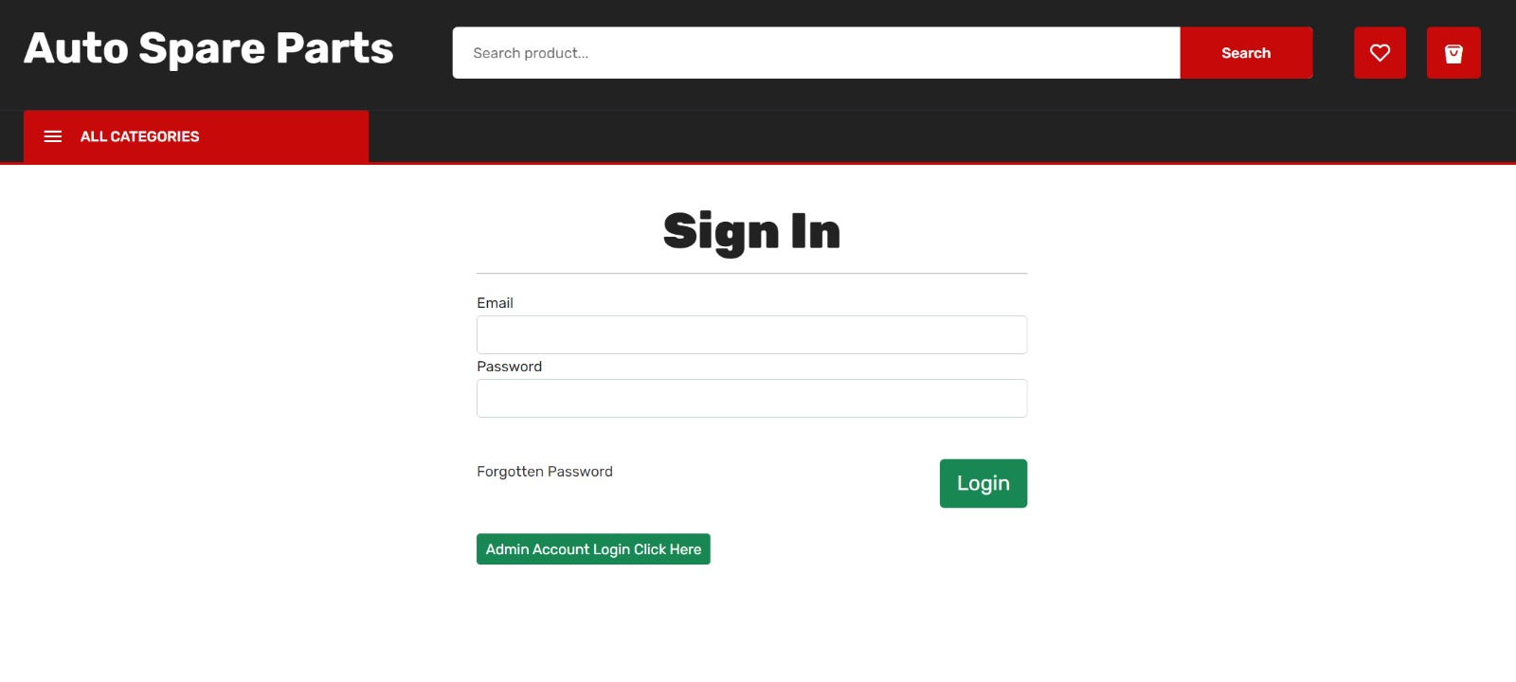
Registration Page
Login Page

Slide 18
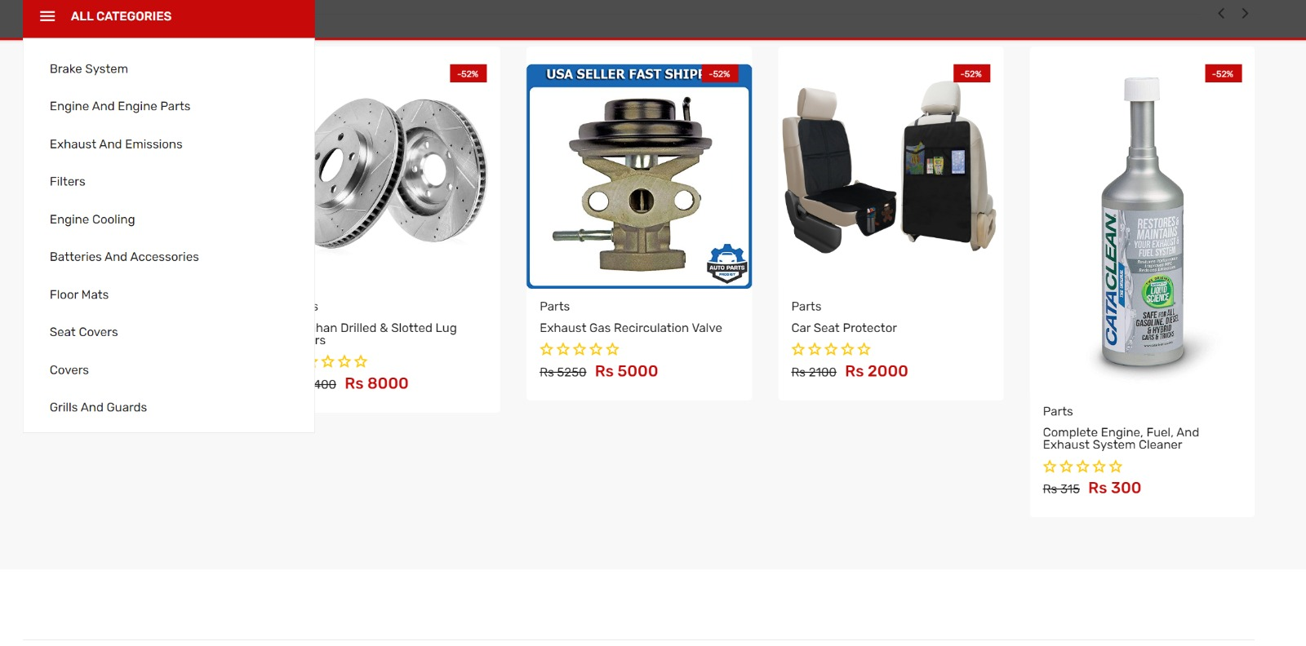
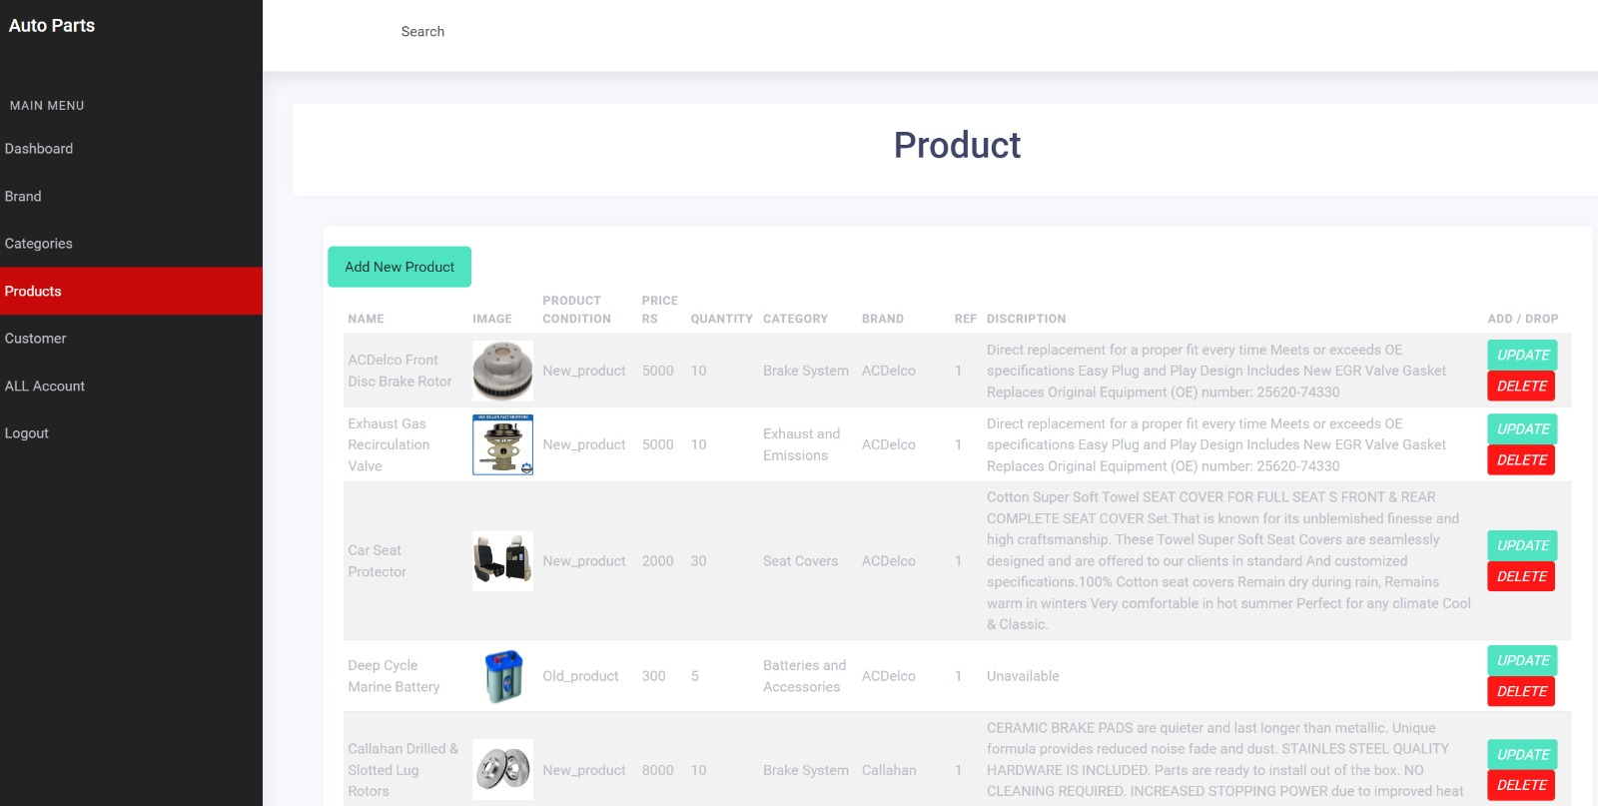
Product Categories
Product Listing

Slide 19
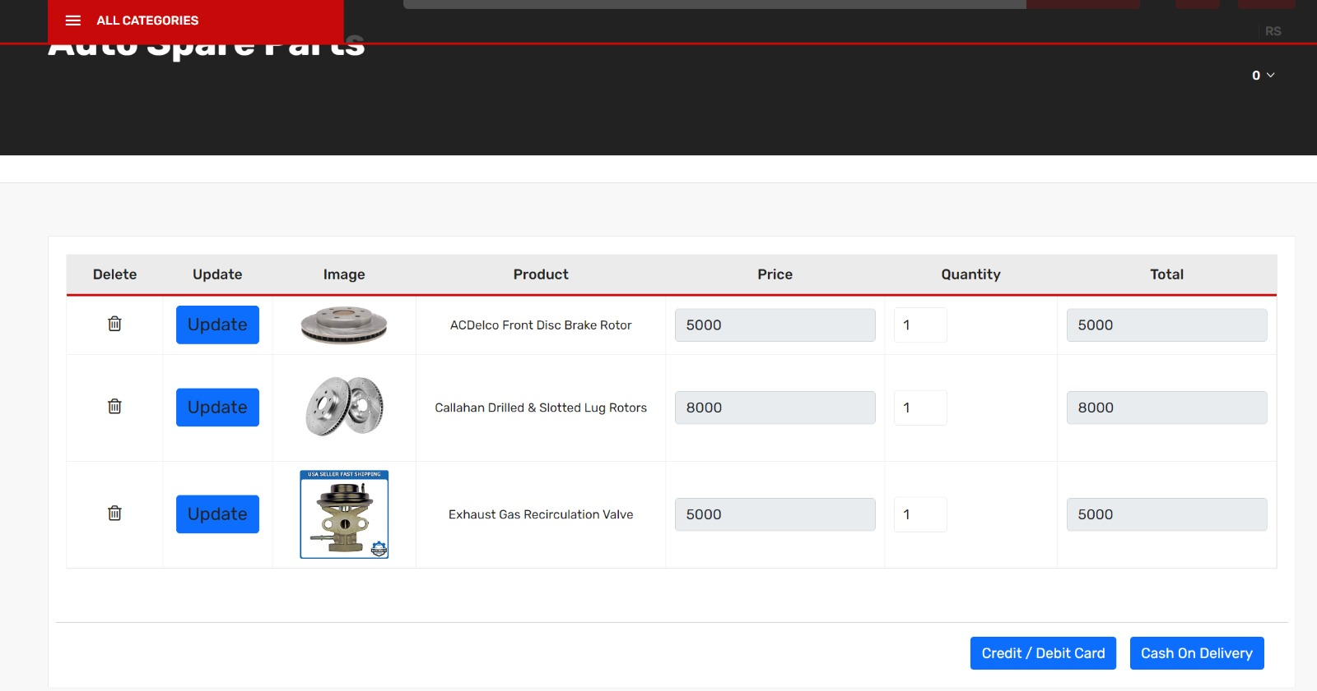
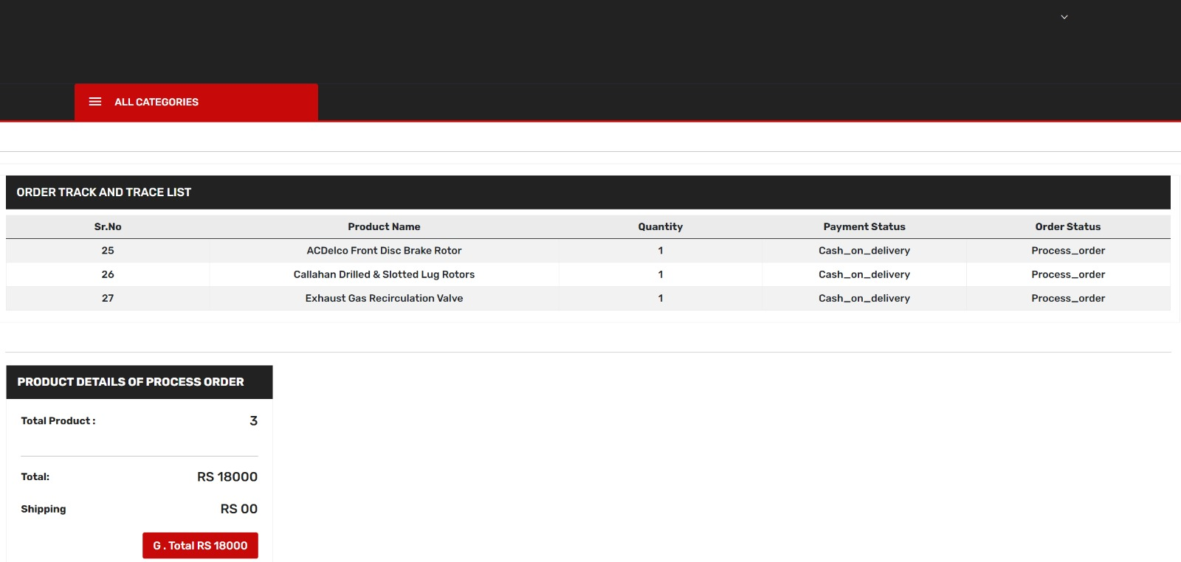
Cart Page
Review Page

Slide 20
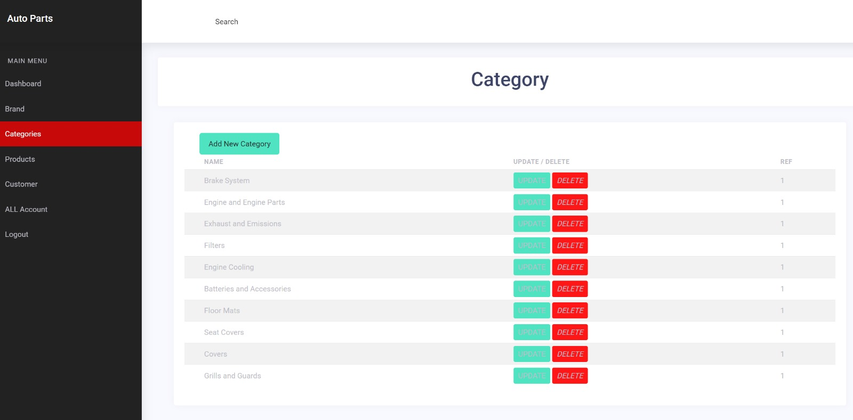
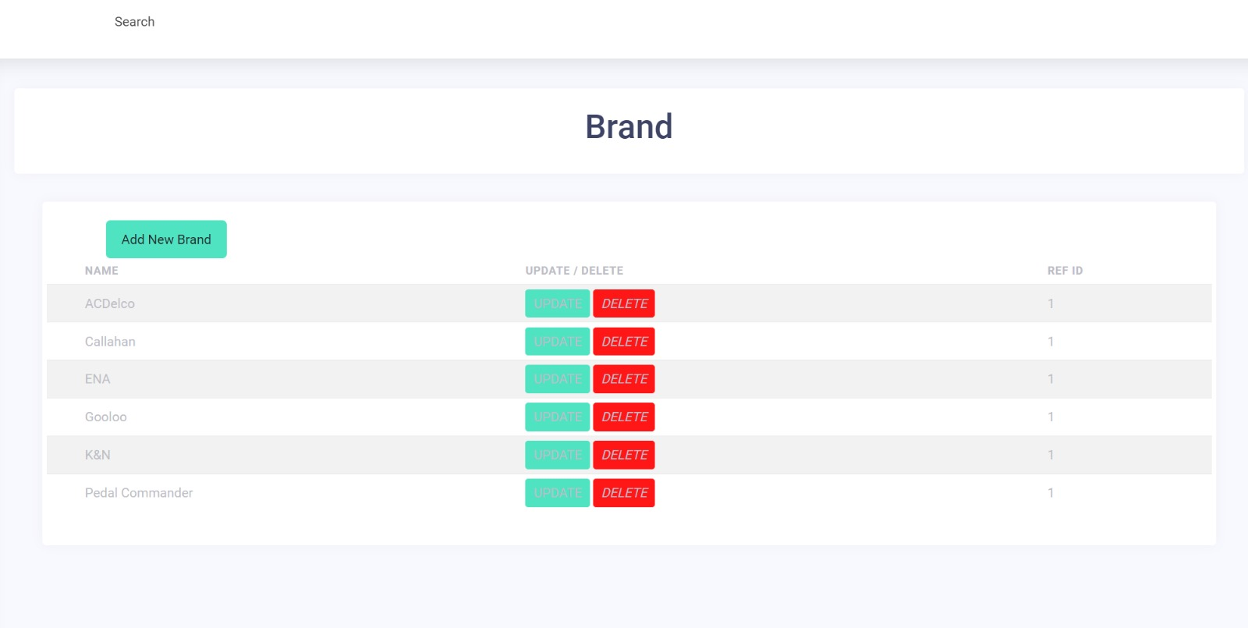
Category Addition
Brand Registration

Slide 21
Result and Analysis
The vehicle monitoring system offers accurate information on all fundamental factors influencing a vehicle's performance.
The vehicle insurance app aids the owner in obtaining the most insurance payout possible if the vehicle develops flaws or malfunctions as a result of normal wear and tear.
The website aims to provide a comprehensive solution to the customers by offering insurance analysis and spare parts e-commerce services.
The development of such a website can pose various challenges, including data accuracy, data privacy and security, technical complexity, and integration of multiple modules.

Slide 22
Journal/Conference Paper Publication Details
Paper has been submitted in the International Conference on Recent Trends in Data Science and its Applications organized by Department of Data Science and Business System, SRMIST Kattankulathur.
The publication is under process.

Slide 23
Thank You

